Slide 1

MATSYODARI SHIKSHAN SANSTHA's College of Engineering & Technology ,JALNA -431203
PROJECT TOPIC : ONLINE AUCTION SYSTEM
SUBMISSION BY :
Gaurav Rohidas Ranyeole (4464)
Harshal Prabhakar Daud (4456)
Ganesh Arjun Tirsule (4441)
Bhakti Dagadu Bhalekar (4404)
Under Guidence : Prof. G.R.Thakur Sir

Slide 2
INTRODUCTION
Design is processes through which requirements are translated into a representation of the software. The purpose of the designing phase is to plan a solution for the problem specified by the requirement document i.e. The requirement are translated into software .Design activities of an result in a three separate outputs:
Architecture design
High level design
Detailed design
System design is a solution a “hoe to “approach to the creation of a new system . The importance phase is composed of several steps . It provides the understanding of procedural detail necessary for the system recommended in the feasibility study. Emphasis is on translating the performance requirement into design specification

Slide 3
AIM
In future we can integrate this web application with mobile apps.
We can add reverse bidding features, gaming bid features in future.

Slide 4
OBJECTIVES
Online Auction is the website application in where participants can bid for the
Products . In online auction project that holds online auctions of various products
On a website and serves sellers and bidders accordingly. The system is designed to allow users to set up their products for auctions and bidders to register and bid for various products available for bidding.

Slide 5
SOFTWARE REQUIREMENTS
IDE : Adobe Dreamweaver CS 6.0
Front-end: PHP 5.2
Back-end: MySQL Server 5.1.1

Slide 6
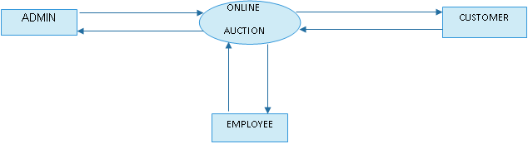
Context Flow Diagram (CFD)
The System Context Diagram or Context Flow Diagram (CFD) describes the external entities acting on the system. The environment in which the system is used is depicted in the figure.

Slide 7
Data Flow Diagram
A Data Flow Diagram (DFD) is a graphical representation of the “flow” of the data through an information System. A DFD also can be used for the visualization of data processing. It is common practice for design to draw a context level DFD first which shows the interaction between the system and outside entities. This context-level DFD is then “exploded” to show more detail of the system being modelled.
Rules Regarding DFD construction:
A process cannot have only outputs.
A process cannot have only inputs.
The inputs to process must be sufficient to produce the outputs from the process.
All data stores must be connected to at least one process.
All data stores must be connected to a source or sink.
A data flow can have only one direction of flow. Multiple data flows to and/or from the same process and data must be shown by separate arrows.
If the exact same data flows to two separate arrows, it should be represented by a forked arrow.

Slide 8
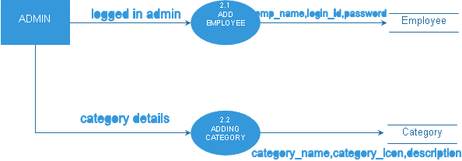
DFD for Level 1 Admin

Slide 9
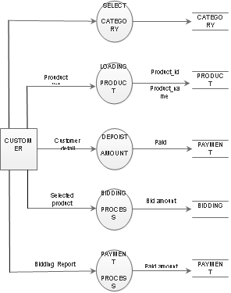
DFD for Level 1 Customer

Slide 10
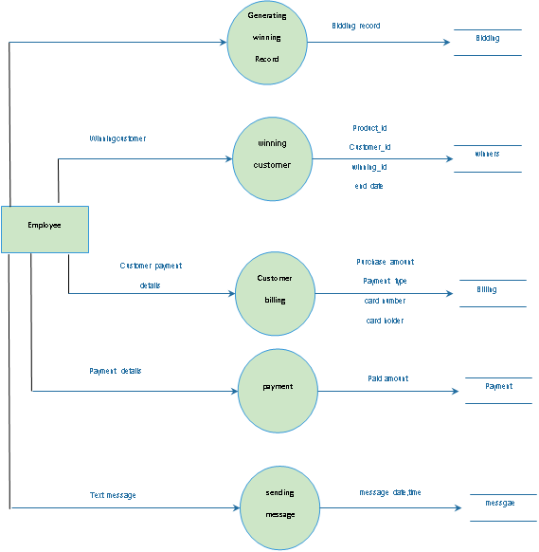
DFD for Level 1 Employee

Slide 11
STRUCTURE CHART OF ADMIN

Slide 12
STRUCTURE CHART OF Employee

Slide 13
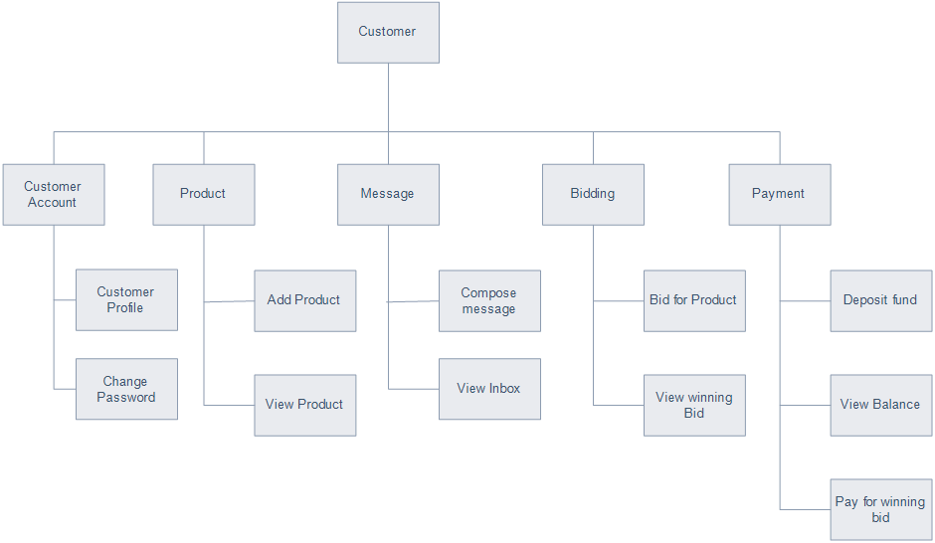
STRUCTURE CHART OF Customer

Slide 14
MODULES
ADMIN
EMPLOYEE
CUSTOMER

Slide 15
ADMIN
REGISTRATION :
At the very first time, the admin has to register. Then everytime he has to login to enter and he can log-out while exiting.
MANAGE AND INSERTING THE CONTENTS :
Admin has the right and the responsibility to add data and information to the Application. He can
also delete or edit the data if necessary.

Slide 16

DELETE/UPDATE DATA :
The admin can update or add any service that is provided for the Customer. Services like adding employee,Categories,etc..

Slide 17
EMPLOYEE
REGISTRATION :
At the very first time, the Employee has to registered by Admin. Then everytime he has to login to enter and he can log-out while exiting.
MANAGE :
Employee has the right and the responsibility only to View the customer and View the recorded data in the Application. Also delete or edit the data if necessary.

Slide 18
FETCHING : The Employee can fetch all the information inputted by
the Customer.
The Employee can fetch the data like payments ,number of
product, number of bidding , etc…

Slide 19
CUSTOMER
REGISTRATION :
The customer should register in the registration page by providing all the necessary details once the registration is completed.
LOGIN :
The customer can login by using his/her Email or Phone.no
And password .

Slide 20
BIDDING :
The customer can select which category he/her wants and there will be several product in the category.
The customer can select product and can start bidding in the given time. Where every customer will be bidding to win the product.

Slide 21
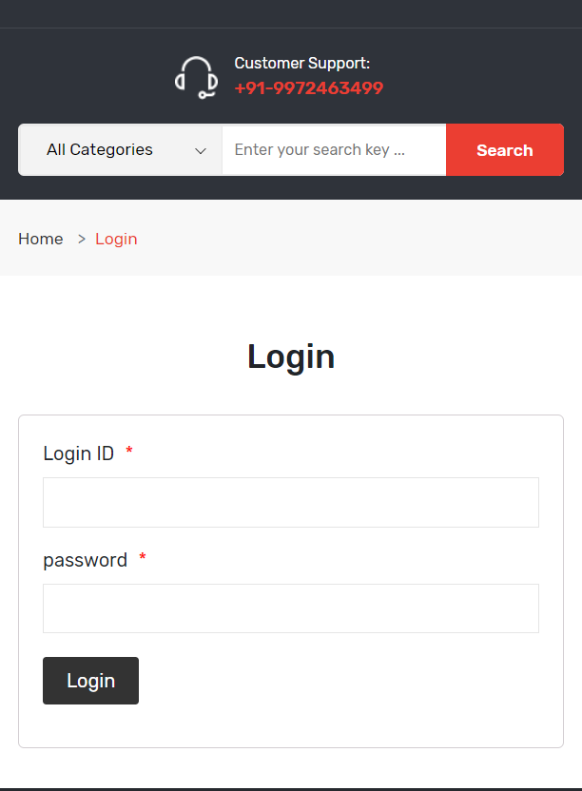
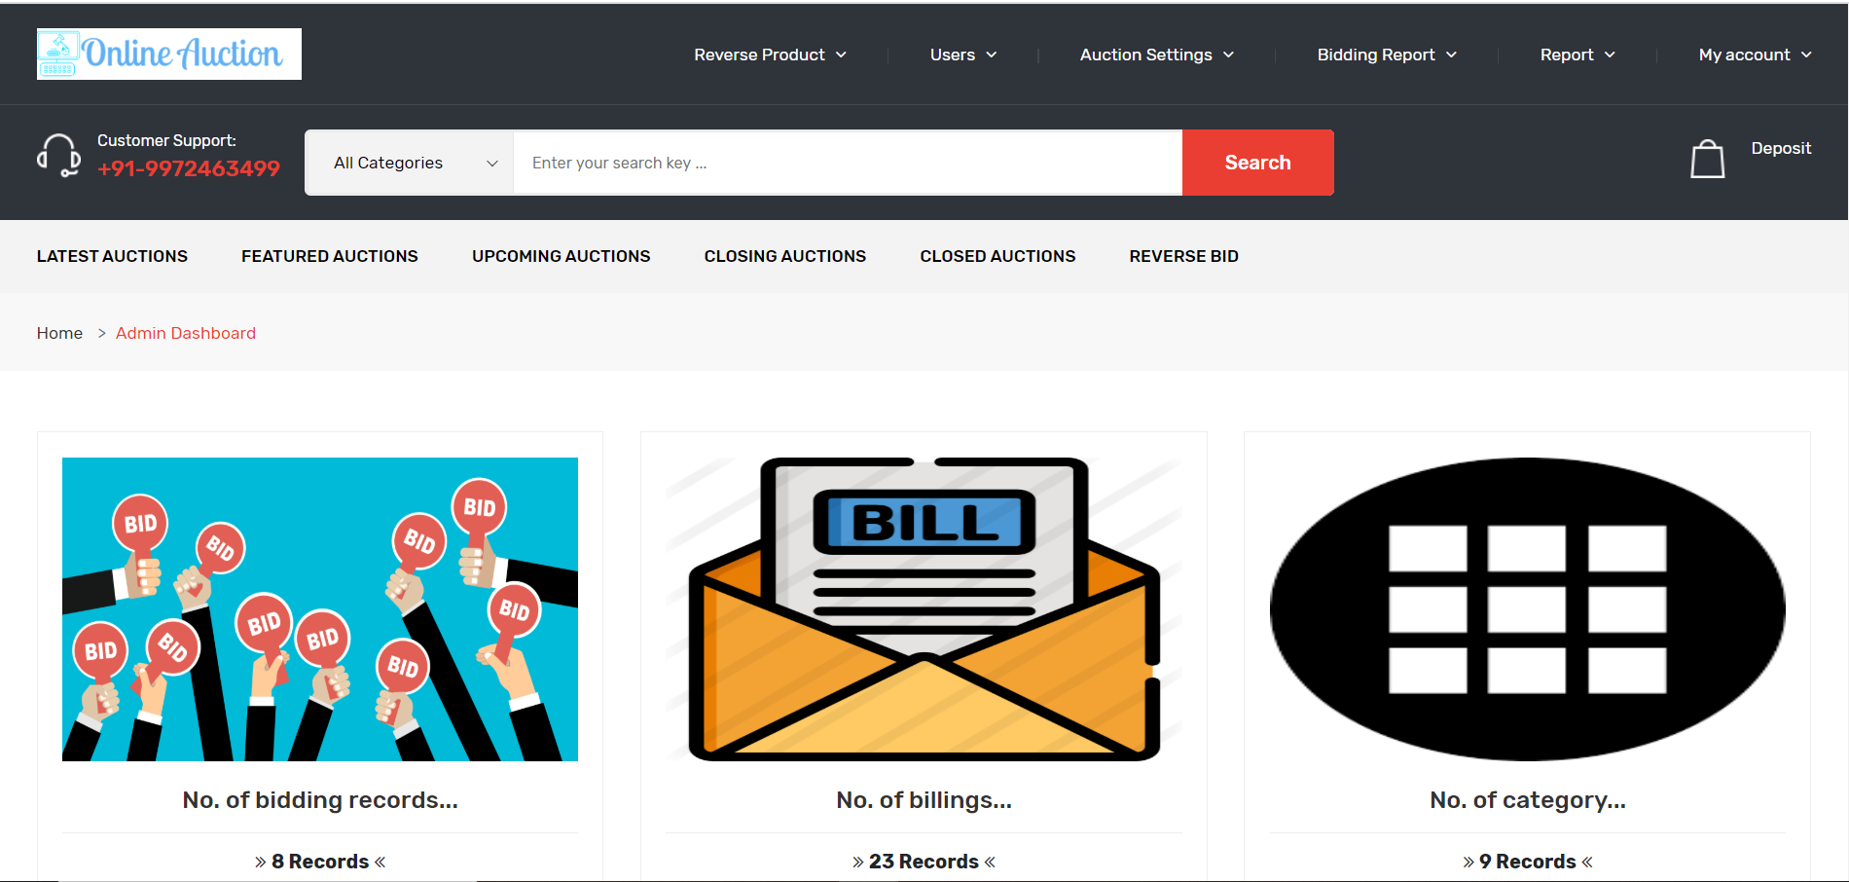
ADMIN

Slide 22
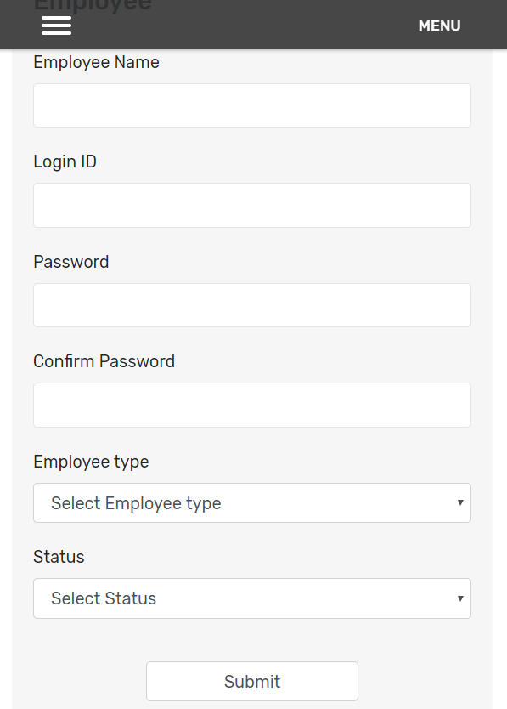
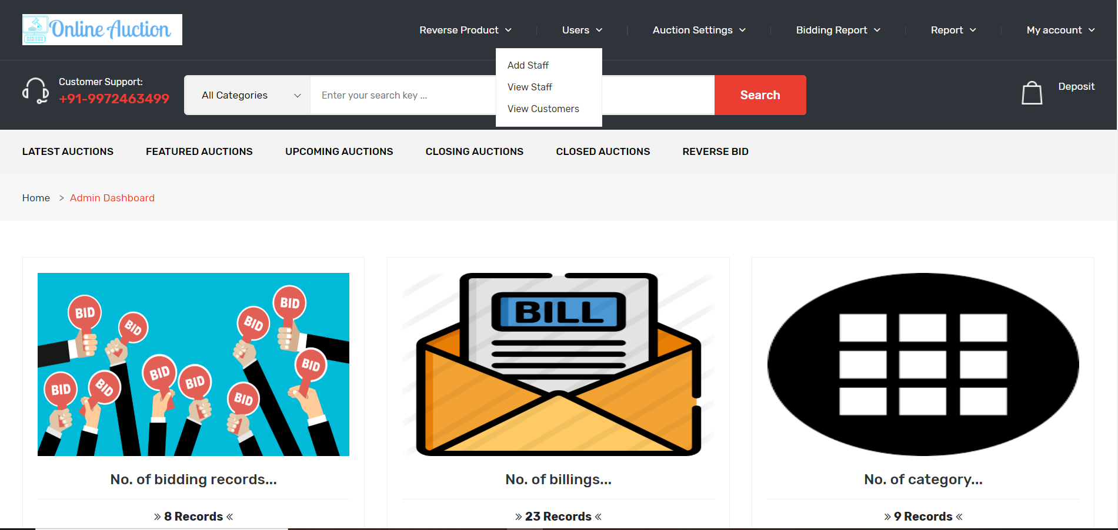
Users

Slide 23
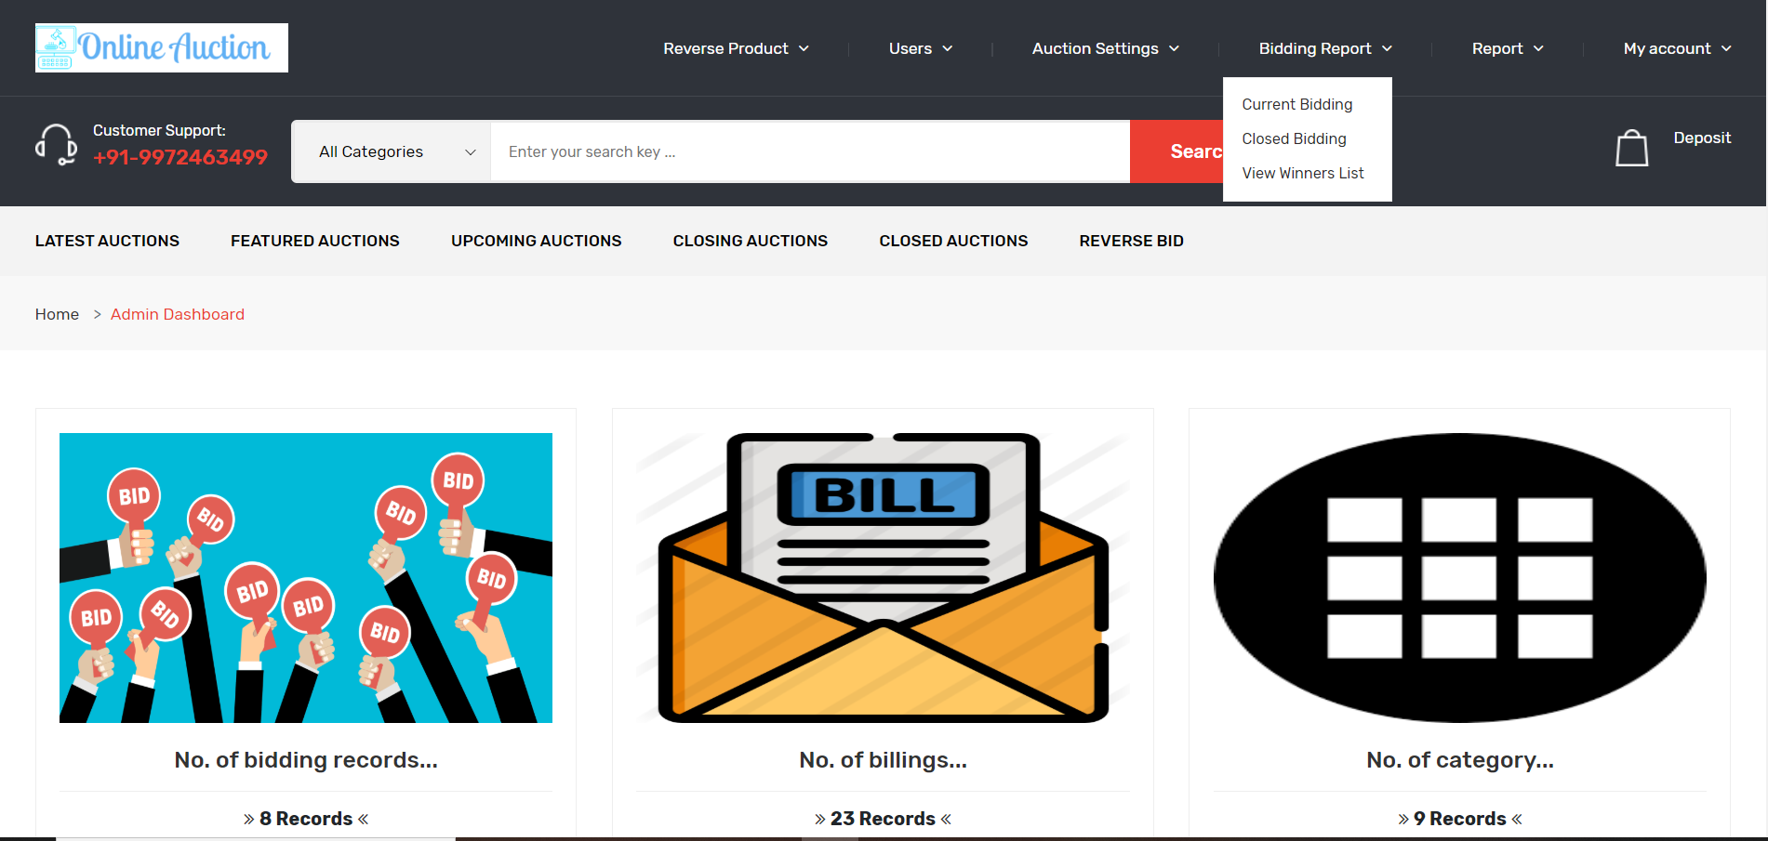
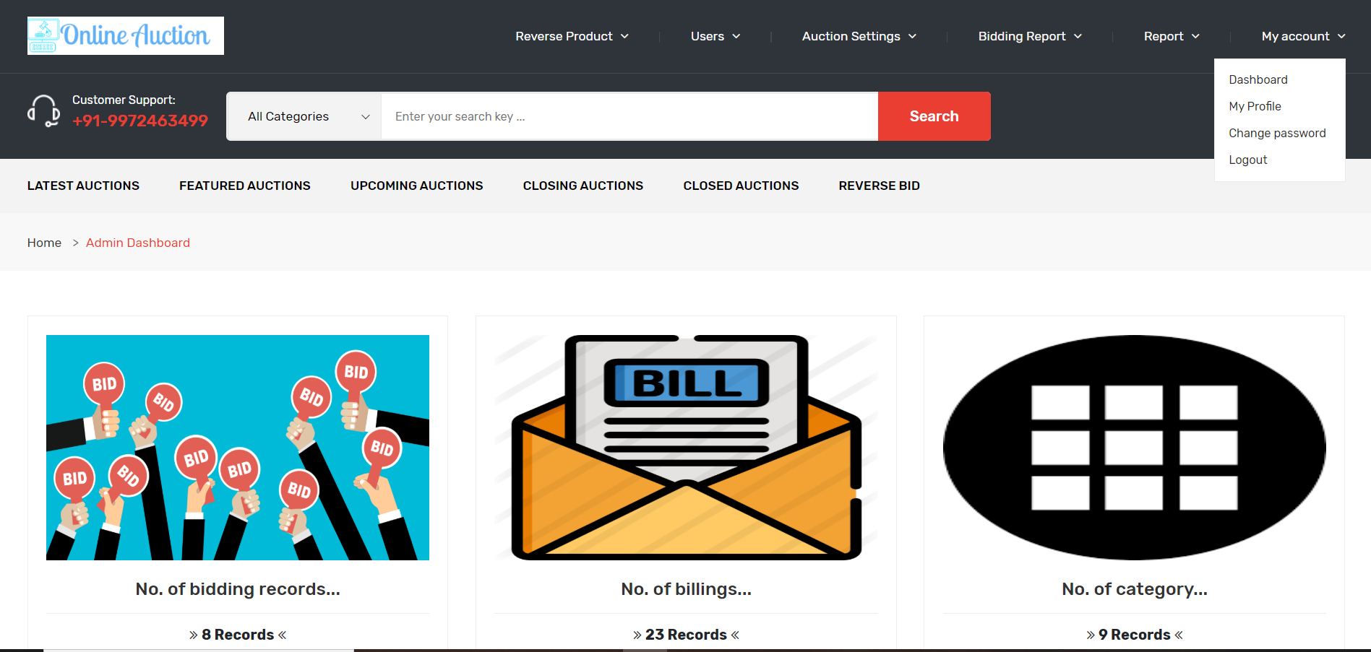

Slide 24
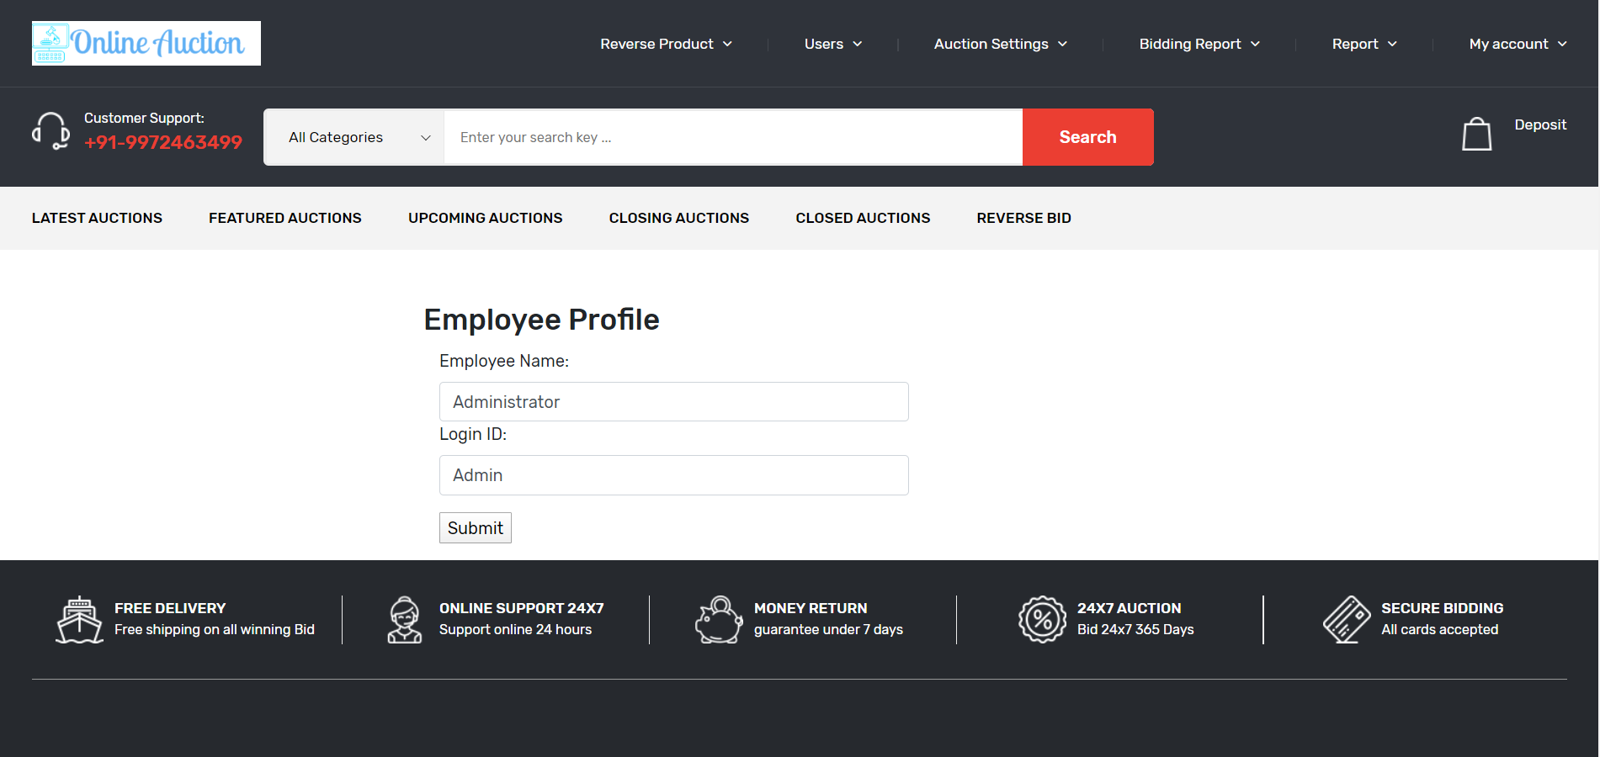
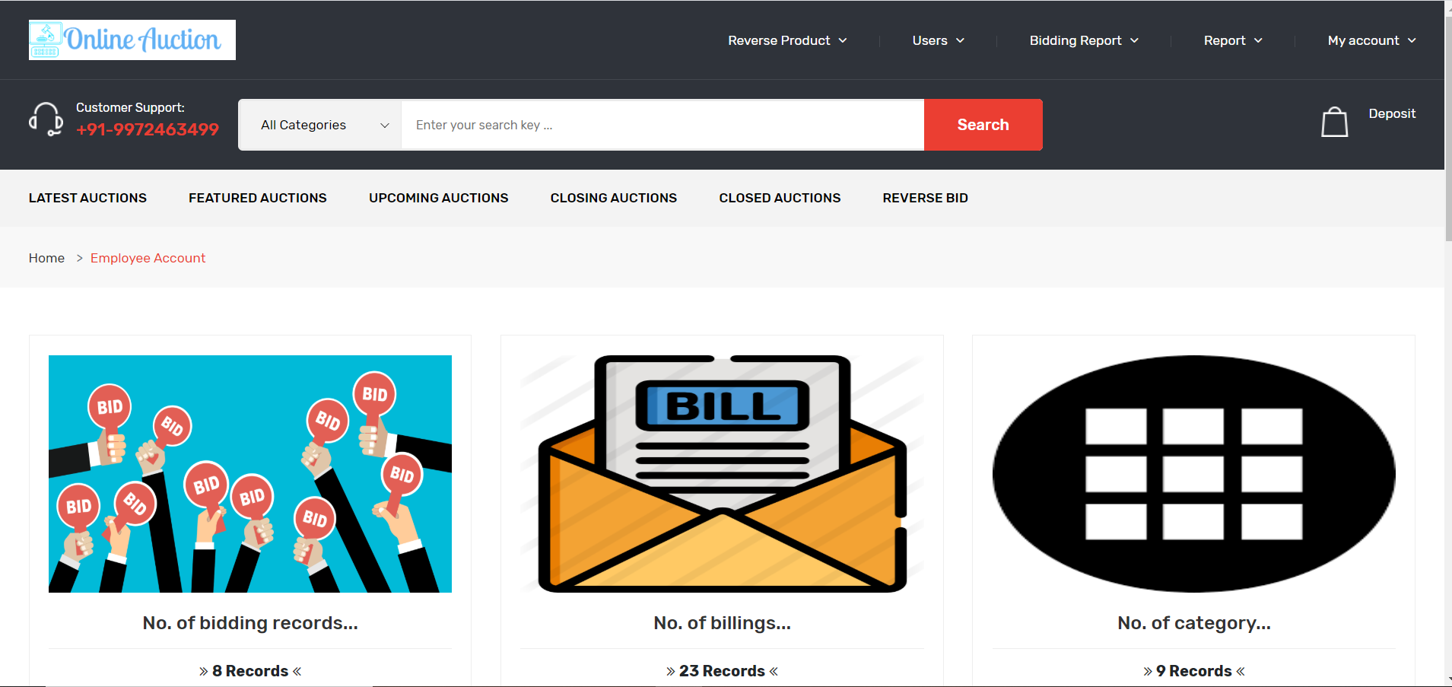
EMPLOYEE

Slide 25
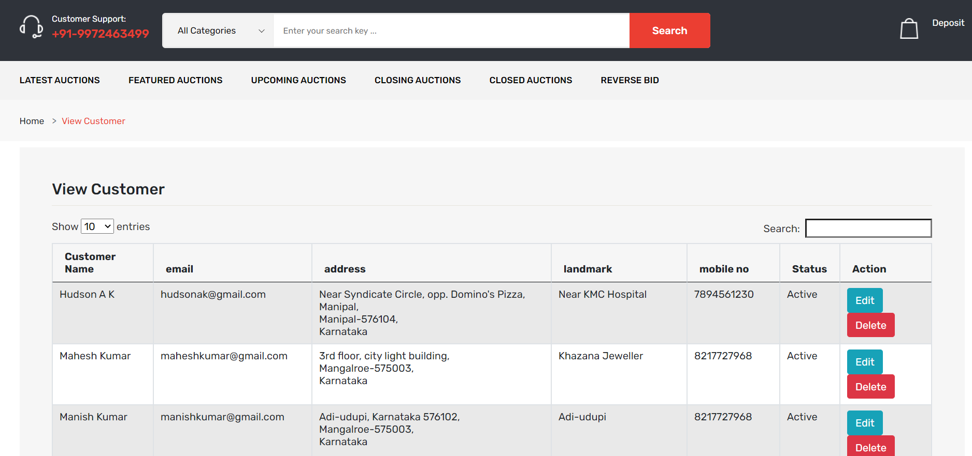
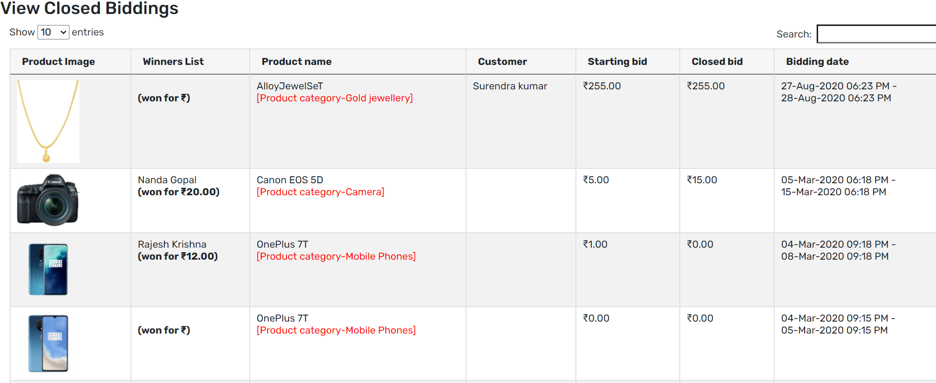

Slide 26
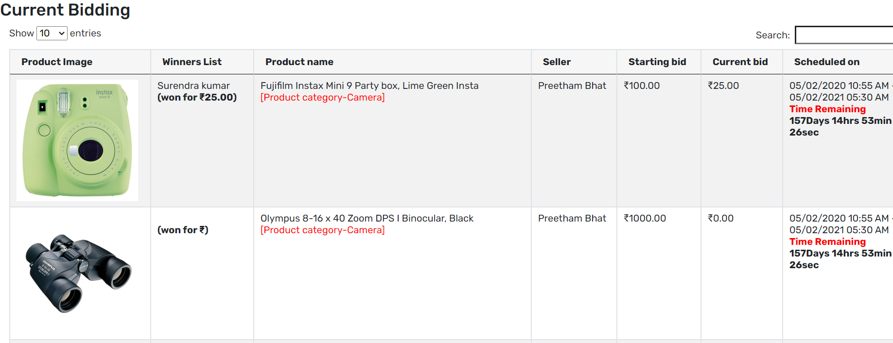
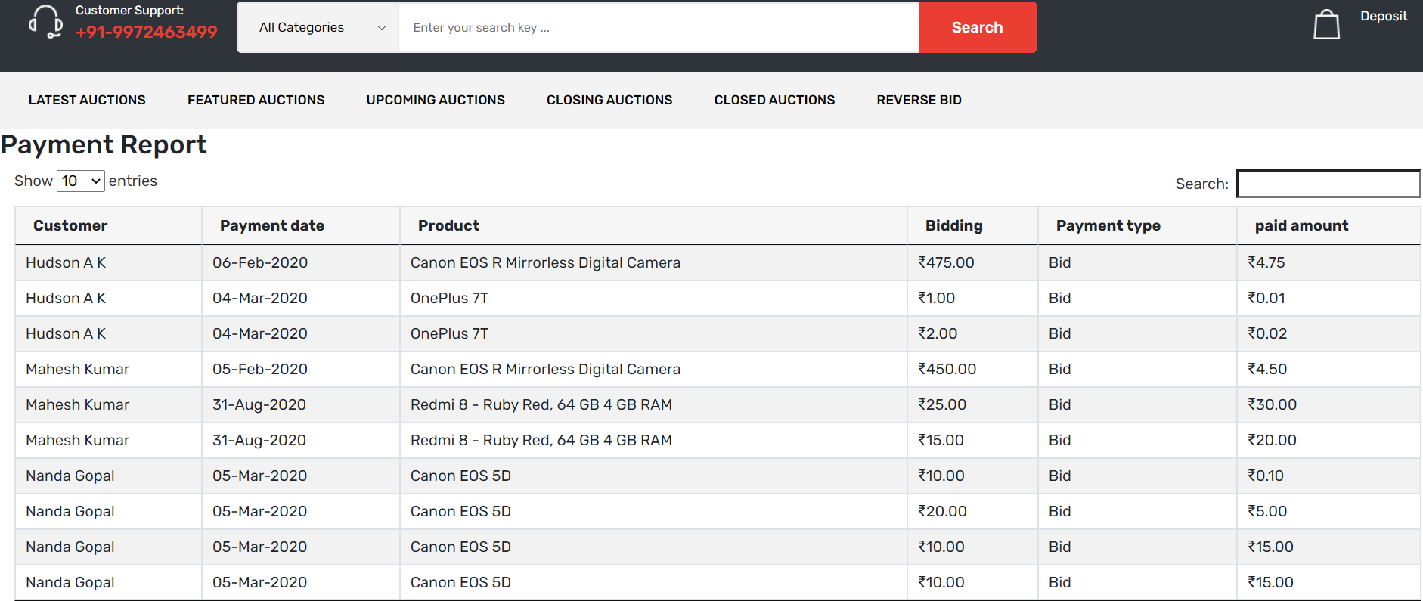

Slide 27
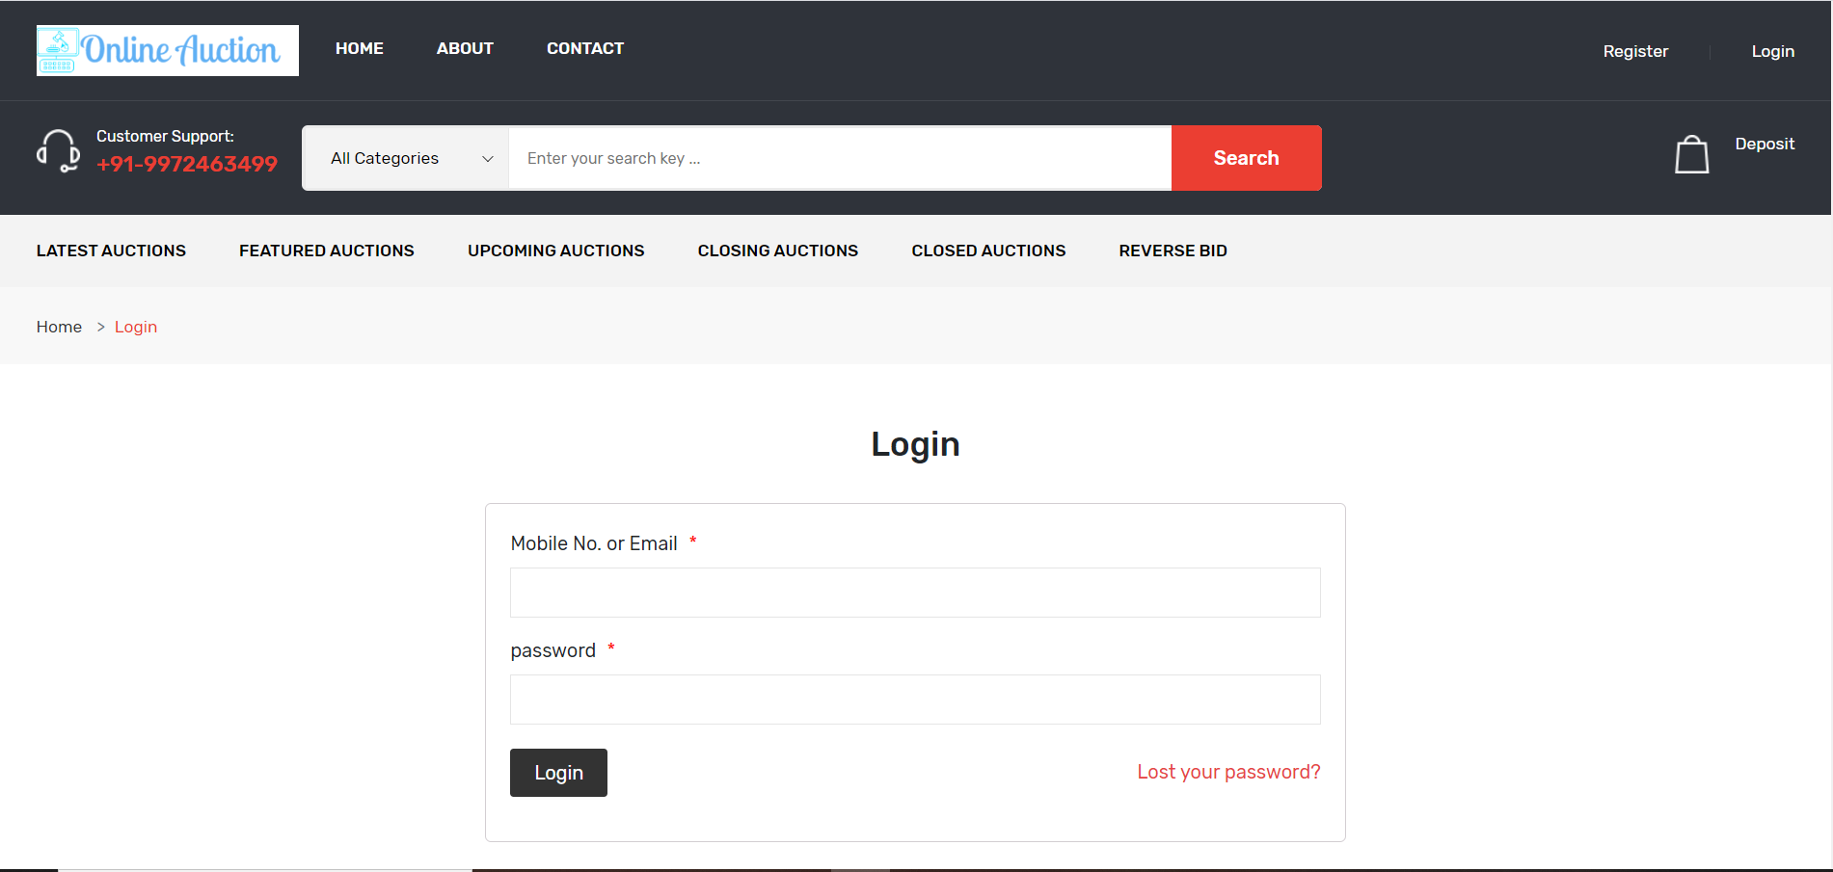
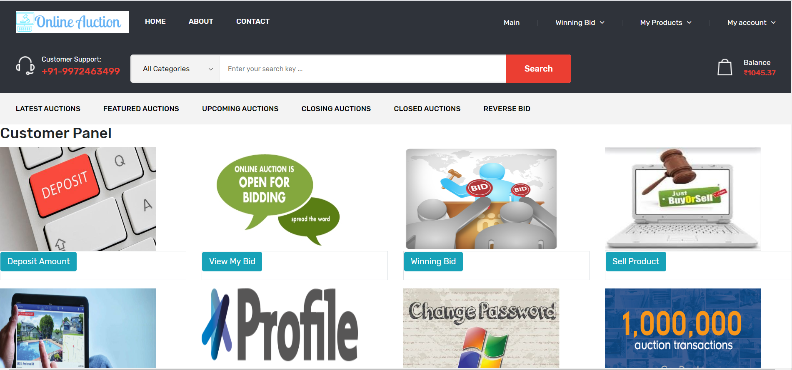
CUSTOMER

Slide 28
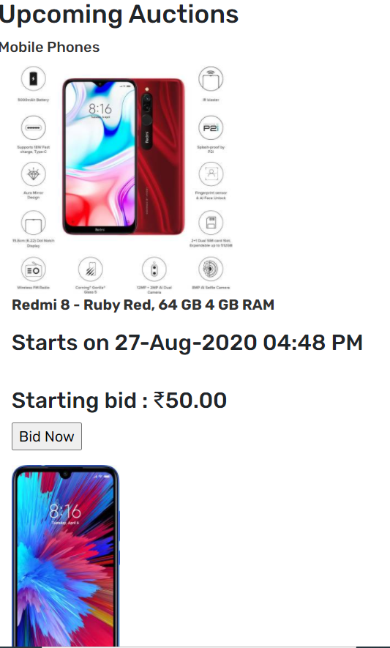
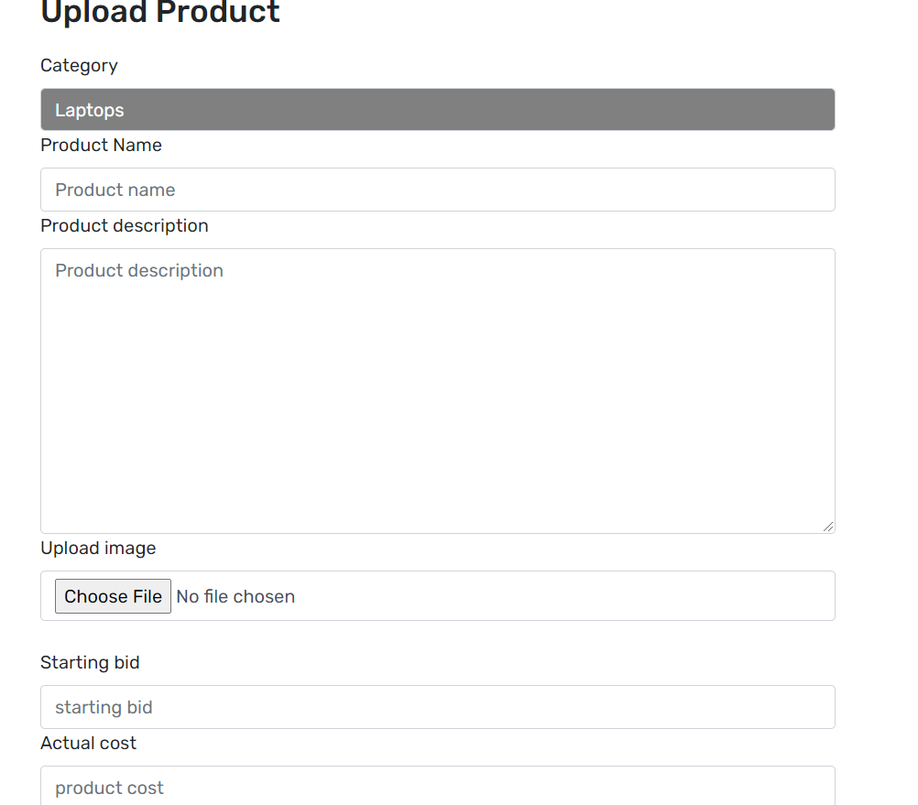

Slide 29
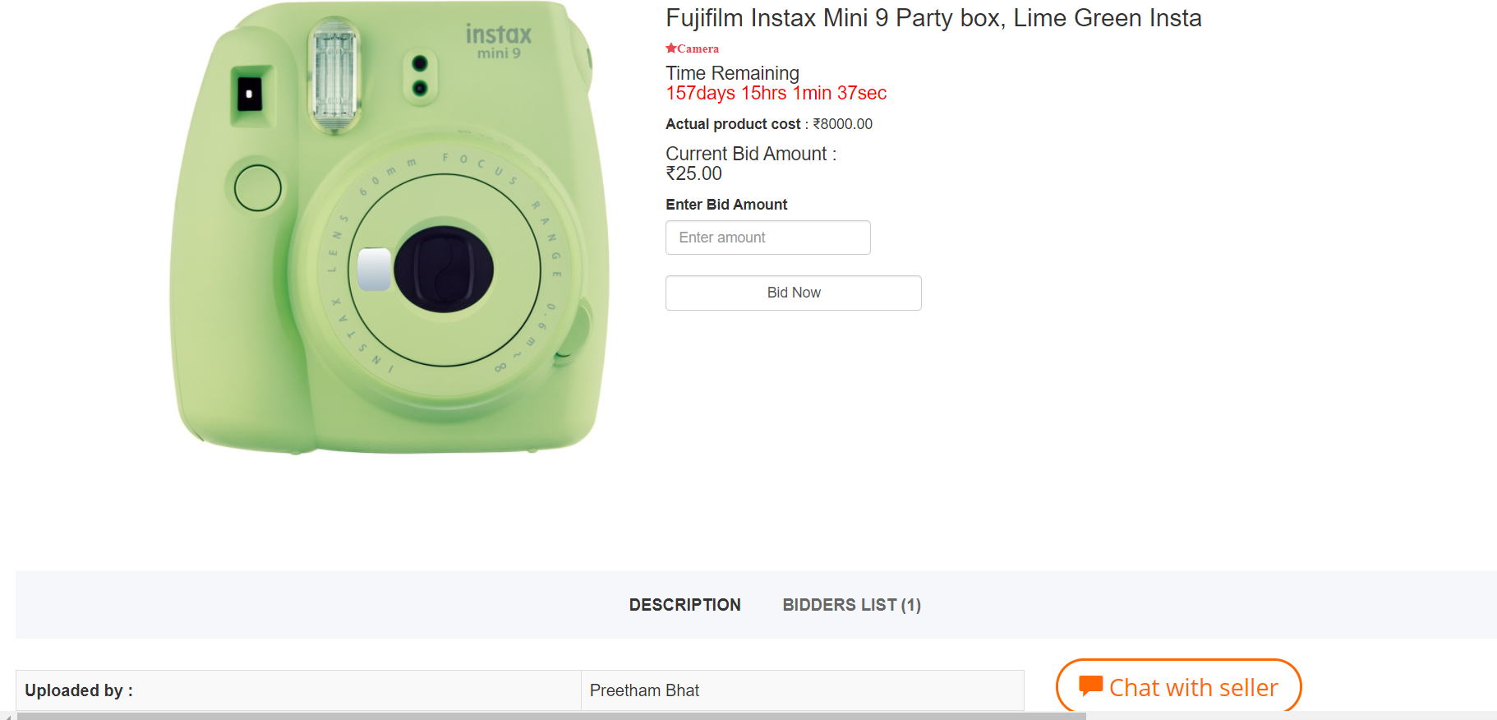

Slide 30
THANK YOU

